Slide 1
Panel Data: Life Expectancy across Countries
Alexander Martinez

Slide 2

Variables
Index:
Individual dimension = Country
Time Dimension = Year
Predictor Variables:
GDP = Gross Domestic Product Per Capita
Totalexp = General Government expenditure on health as a percentage of total government expenditure (%)
Adultmort = Adult Mortality Rates of both sexes (probability of dying between 15 and 60 years per 1000 population)
Schooling = # of years in schooling
developing = Dummy variable that 1 when a country is developing and 0 when a country is developed.
Response Variable:
Lifexp = Life Expectancy in age

Slide 3
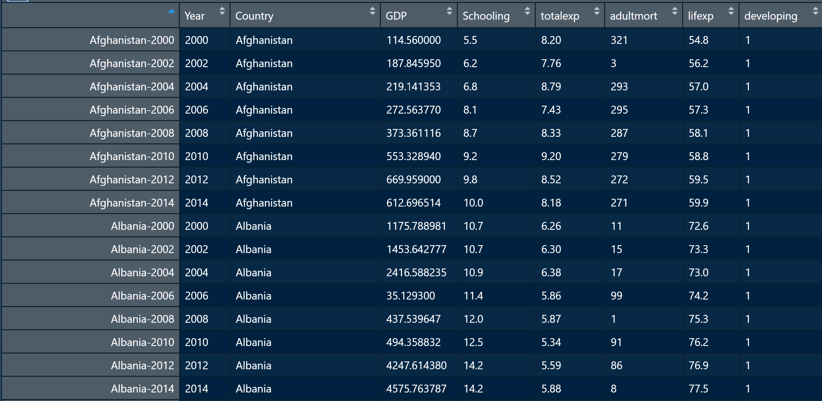
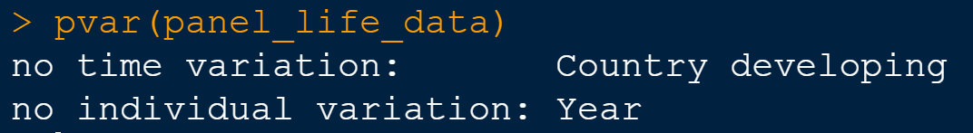
Data
To get an idea of what the dataset looks like
Worth Noting: Developing has no time variation

Slide 4
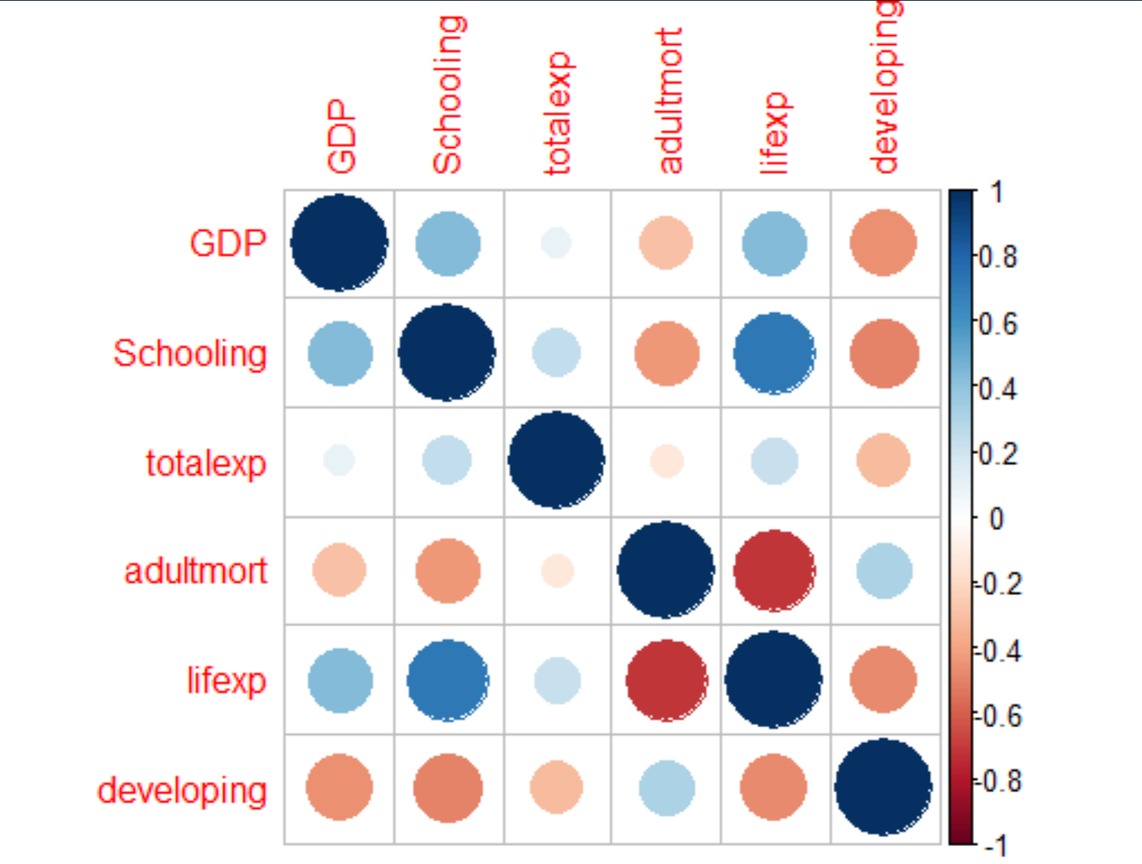
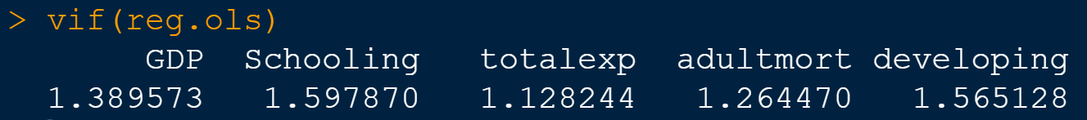
Exploratory analysis
Correlation between the independent variables
Although there seems that there can possibly be multicollinearity between the independent variables, I was able to calculate the Variable Inflation Factor (VIF) and found that they do not SEEM to have PERFECT multicollinearity
VIF < 5

Slide 5
Model to be analyzed
The model consists of all the variables defined at the beginning.
The plm() in R recognizes that the data is panel data, and there are options in this function that allow us to choose what model-type we want to run
The models that we will use are “Pooling” (OLS), “Random”(RE), and “Within” (FE)

Slide 6
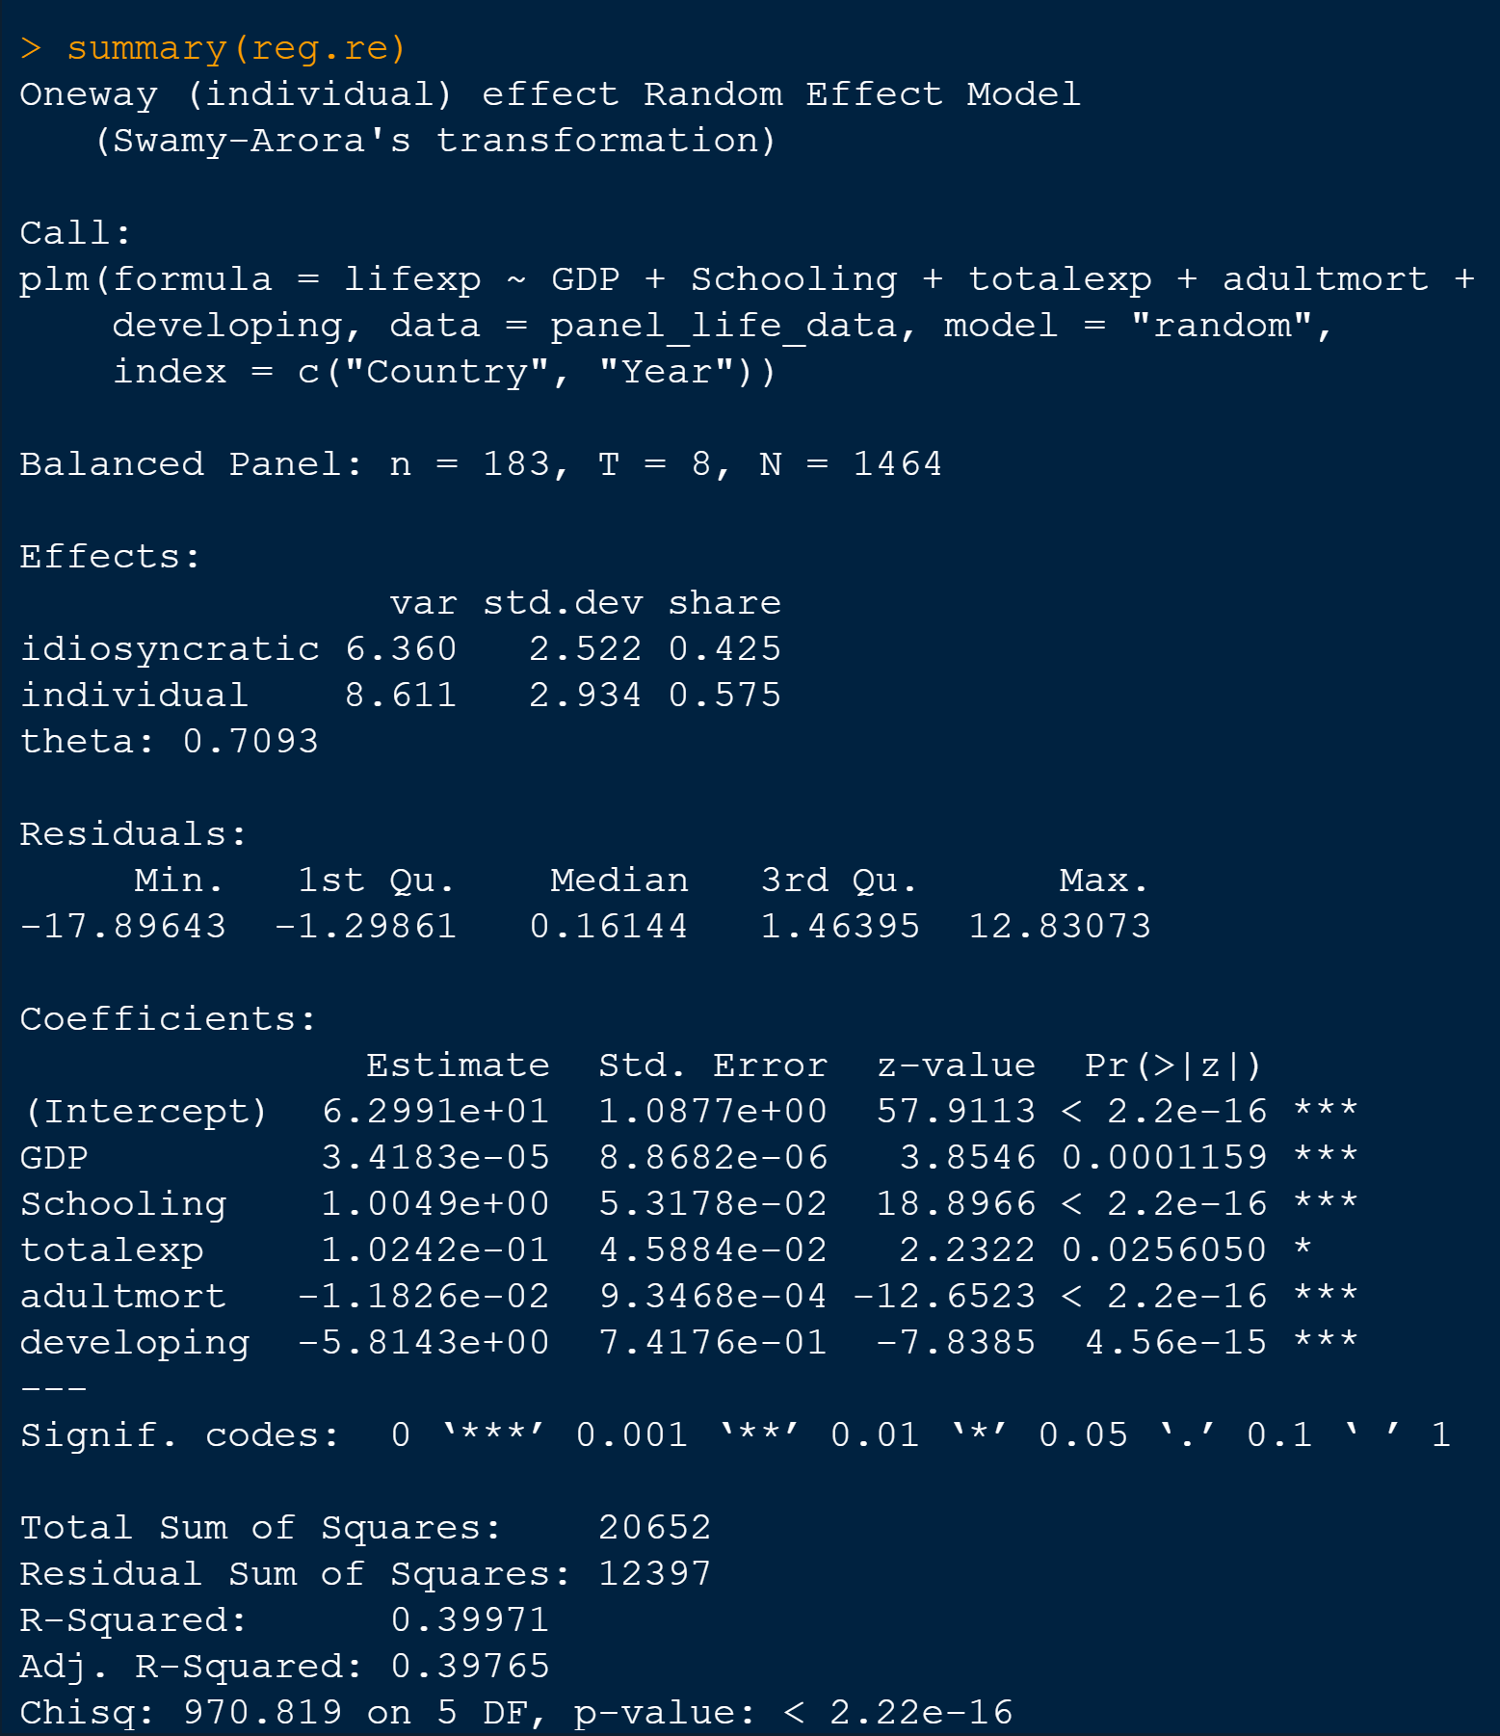
Model Analysis: Random Effects
The Chi-Squared statistics reveals that the Overall model is significant.
The p values of each variable also indicate that, the Residual sum of squares is ~12400

Slide 7
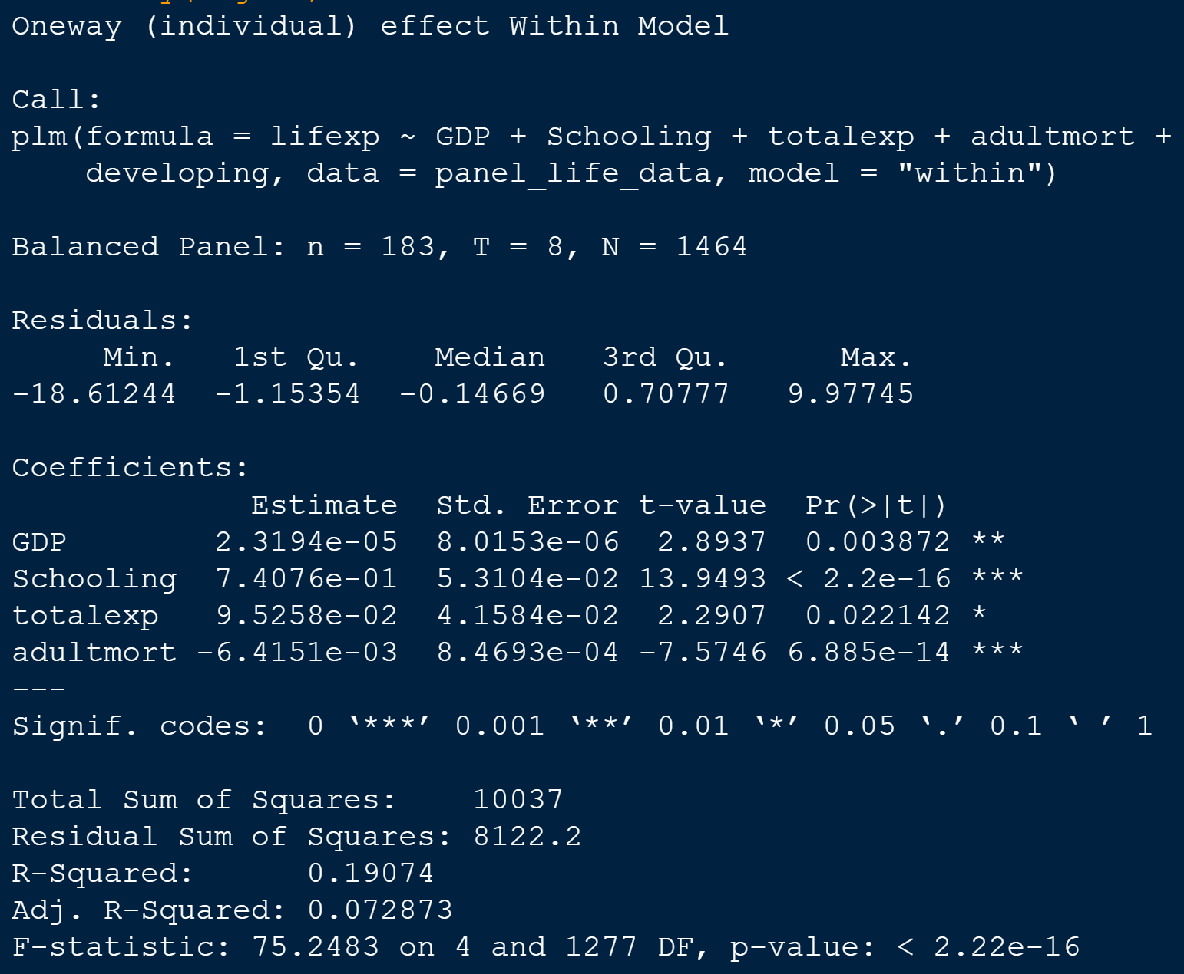
Model Analysis: Fixed Effects
The model has the lowest Residual Sum of Squares, the R squared does get lower, and the overall model seems to be significant

Slide 8
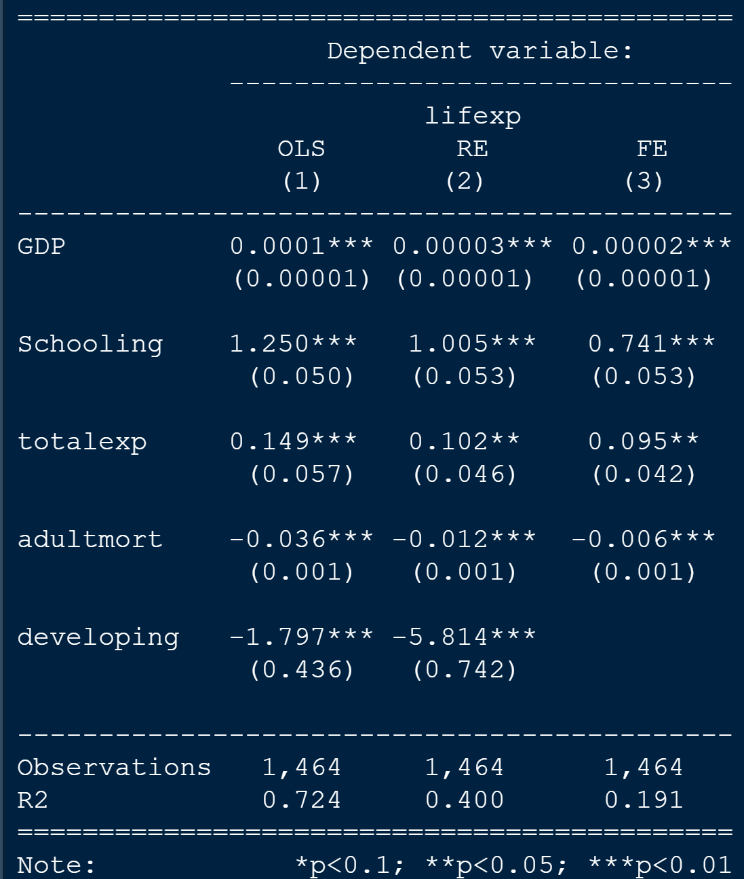
Comparing all the coefficients
As we can see, all of the models show that every one of the coefficients are significant, but the question is
What Model is best for analysis?

Slide 9
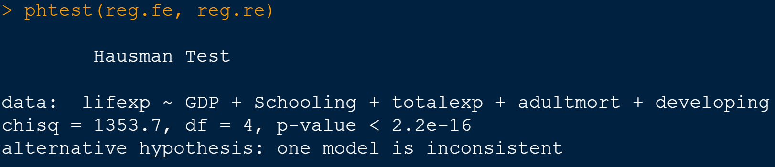
Hausman Test: Fixed or Random?
This Tests whether the Unique errors are correlated with the regressors or not.
The Null Hypothesis is that they are not, which would tell us to use RE over FE.
As we can see, the test rejects the null and we use the fixed effects over the random effects because the random effects Is not consistent

Slide 10
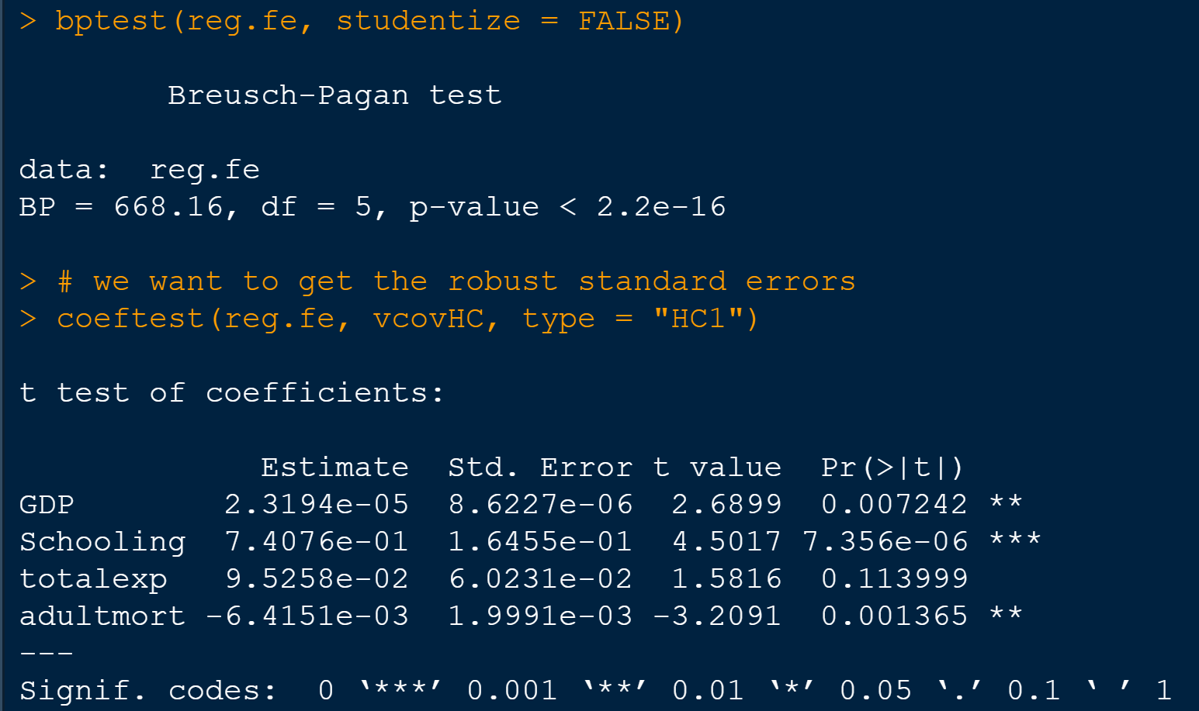
Test For Heteroskedasticity: Implement Robust errors
H0: there is Homoscedasticity
We reject the null and conclude there is a heteroskedasticity.
We then get the robust standard errors
We find that, according to this model, total expenditure on health as a percentage of GDP does not have a significant effect on life expectancy, while everything else does.

Slide 11
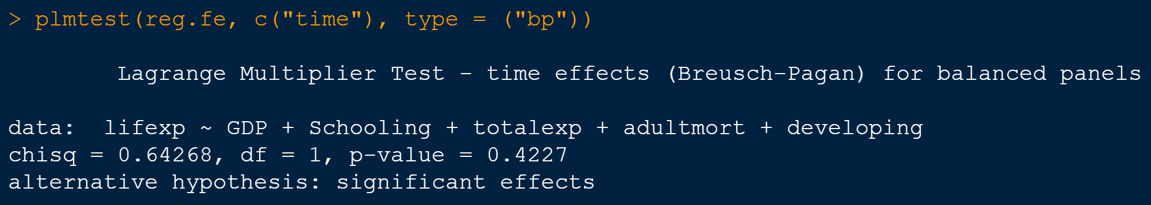
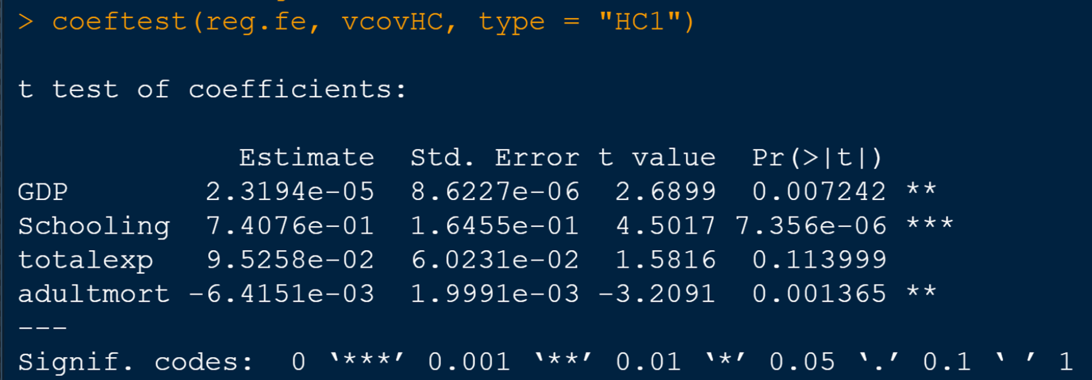
Do we need to use time fixed effects?
H0: No time-fixed effects are needed
Do not reject null and conclude that there Is no need to use time-fixed effects

Slide 12

THe ENd

